Slide 1
DYNAMIC PROGRAMMING
CS 131
OJASVI SHRIVASTAVA

Slide 2

What is dynamic programming?
A powerful technique for solving optimization problems
Can be used to solve a wide variety of problems
Based on the principle of optimality

Slide 3
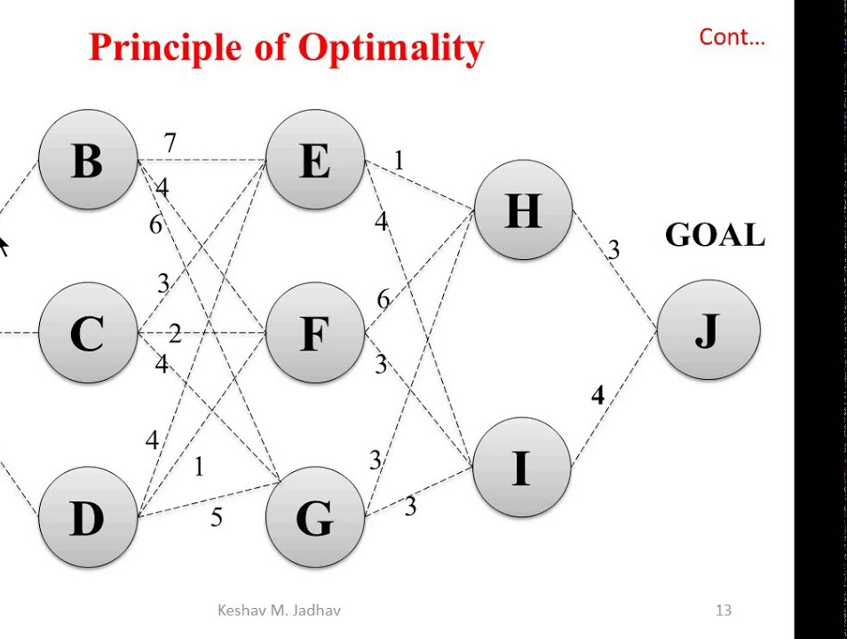
PRINCIPLES OF optimality
An optimal solution to a problem can be constructed from optimal solutions to its subproblems.

Slide 4

Applications of Dynamic Programming
Dynamic programming has a wide range of applications, including:
Shortest path: Finding the shortest path between two points in a graph.
Knapsack problem: Finding the subset of items that maximizes the total value subject to a weight constraint.
Optimal scheduling: Scheduling a set of tasks to minimize the total completion time.
Sequence alignment: Aligning two sequences to maximize the number of matches.

Slide 5
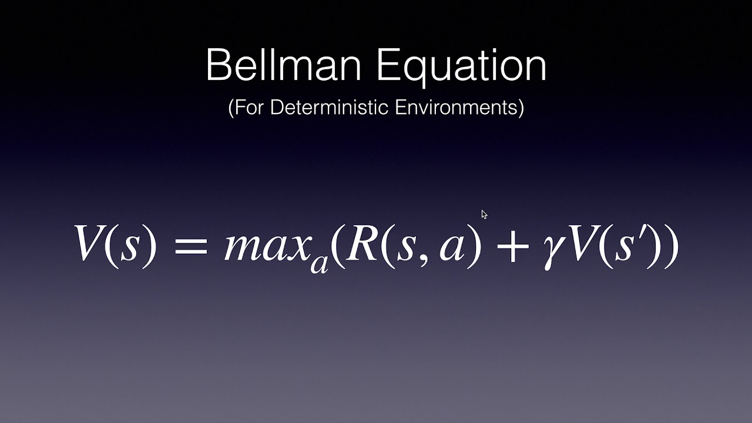
BELLMAN’S EQUATION
V*(s): Optimal value of state s
R(s, a): Immediate reward for taking action a in state s
γ: Discount factor
Σ_s' P(s'|s, a): Sum over all possible next states s' of the probability of transitioning to state s' from state s after taking action a, multiplied by the optimal value of state s’.
Break down the problem into smaller subproblems
Define the state, action, and reward functions
Compute the optimal value function using the Bellman equation
Identify the optimal policy

Slide 6
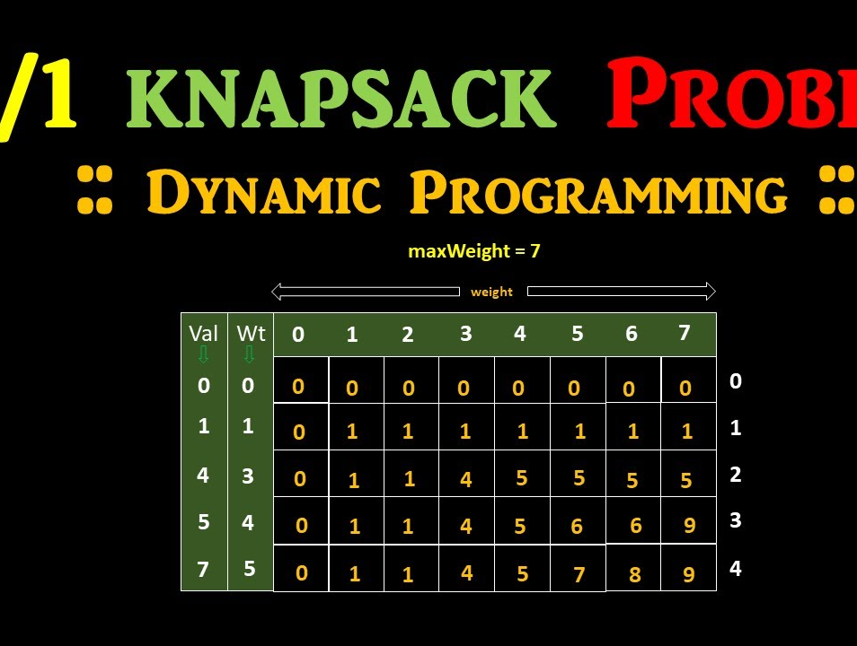
KNAPSACK PROBLEM
Objective: Select the subset of items that maximizes the total value while not exceeding the knapsack's weight capacity.
Constraints:
  Each item has a weight and a value.
  The total weight of the selected items must not exceed the knapsack's capacity.

Slide 7
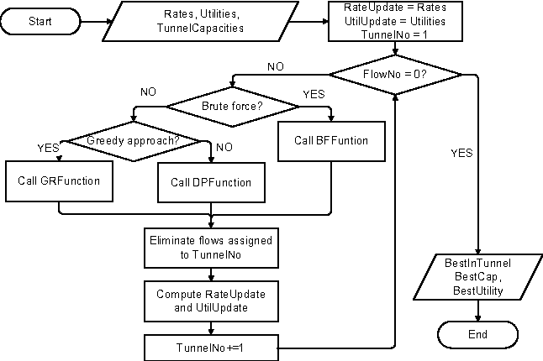
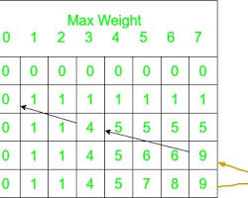
Explore all possible subsets of items
Calculate the total weight and total value of each subset
Identify the subset with the maximum total value within the weight capacity
Define states and subproblems
Recursively compute optimal values for subproblems
Construct the optimal solution from the optimal values

Slide 8
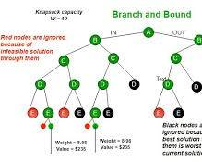
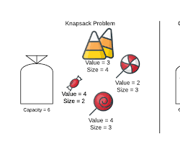
Trace back through the optimal values to identify the selected items
The optimal solution consists of items that contribute to the maximum total value without exceeding the weight capacity.
Resource allocation: Selecting the most valuable projects or investments within a budget constraint.
Scheduling: Optimizing the order of tasks or activities to maximize productivity while meeting time constraints.
Finance: Portfolio selection, investment planning, and asset allocation.

Slide 9
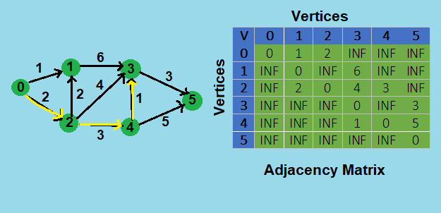
SHORTEST PATH PROBLEM
Objective: Find the path with the minimum total weight between two specified nodes in a graph.
Constraints:
The graph may contain directed or undirected edges.
Edge weights represent the distance or cost of traversing an edge.
The path must connect the source node to the destination node.

Slide 10
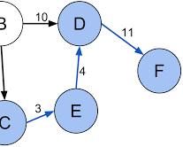
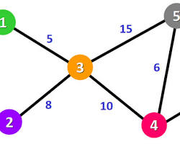
Define states and subproblems
Recursively compute shortest distances for subproblems
Construct the shortest path from the shortest distances
Trace back through the shortest distances to identify the path nodes.
The shortest path consists of the nodes that contribute to the minimum total distance from the source node to the destination node

Slide 11
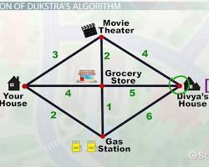
Navigation systems: Finding the fastest route between two locations on a map.
Network optimization: Optimizing data routing and traffic flow in computer networks.
Transportation planning: Designing efficient transportation systems and minimizing travel times.

Slide 12
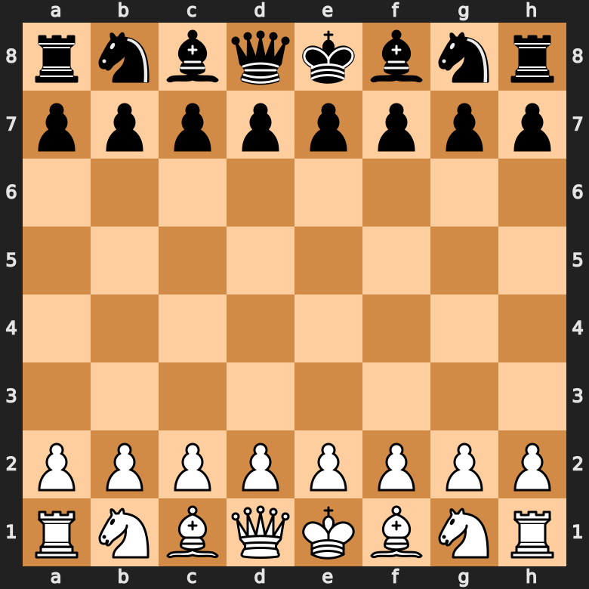
GAME OF CHESS
Dynamic programming in chess involves evaluating the strength of each position, considering factors such as piece mobility, control of key squares, and potential threats. The evaluation function, the heart of the dynamic programming approach, assigns a numerical value to each position, reflecting its relative strength.
The evaluation function, the core of dynamic programming in chess, translates strategic factors into numerical values. Common factors include piece mobility, control of key squares, pawn structure, and king safety. Each factor is assigned a weight, reflecting its relative importance in the overall evaluation.

Slide 13
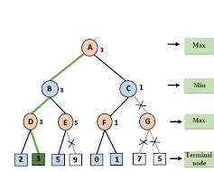
Alpha-beta pruning, a powerful optimization technique, significantly enhances the efficiency of dynamic programming in chess. It eliminates branches of the search tree that cannot affect the outcome, reducing the computational complexity and enabling the algorithm to evaluate more positions.
Dynamic programming has found widespread applications in chess analysis and competition. Chess engines employ dynamic programming algorithms to evaluate positions, analyze potential moves, and suggest optimal strategies. Additionally, grandmasters and chess enthusiasts utilize dynamic programming-based software to analyze their games, identify mistakes, and improve their strategic understanding.

Slide 14

Advantages of Dynamic Programming
Provides a general framework for solving optimization problems
Can handle complex decision processes with multiple states and actions
Can be used to find optimal solutions for problems with uncertainty.

Slide 15

CONCLUSION
The Bellman equation is a powerful tool for solving optimization problems.
It provides a recursive formula for computing the optimal value of a state.
Dynamic programming can be applied to a wide variety of problems.

Slide 16
THANK
YOU

